Slide 1

Human Resource Information System (HRIS)
BY: Ashutosh Kalyankar
Kalp Desai
Sayyad AdnanAhemad

Slide 2

Progress

Slide 3
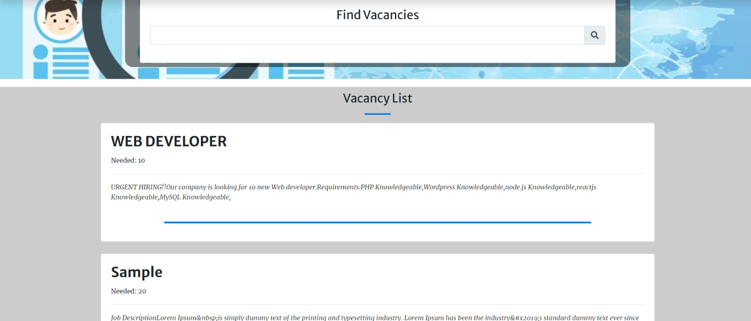

Slide 4
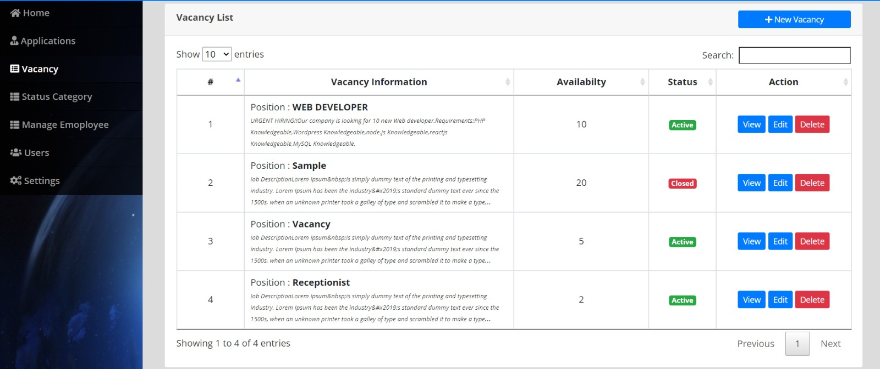

Slide 5
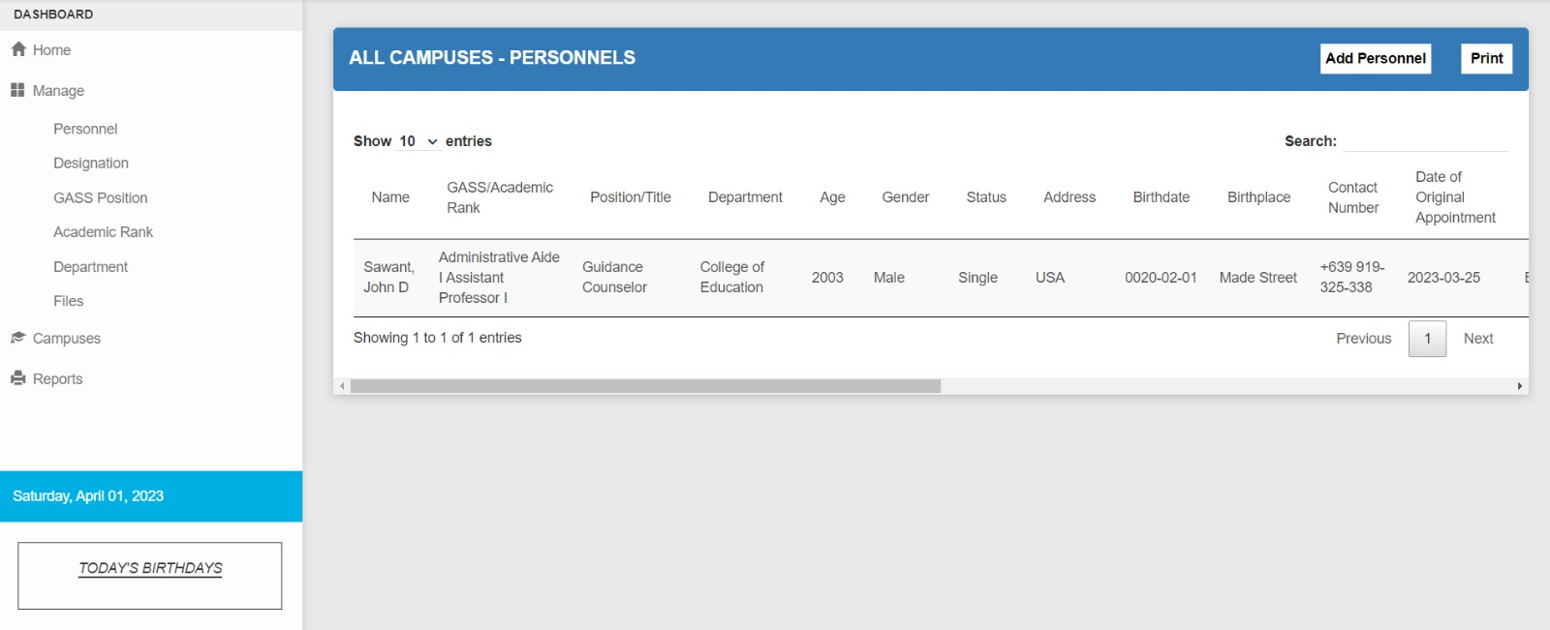

Slide 6
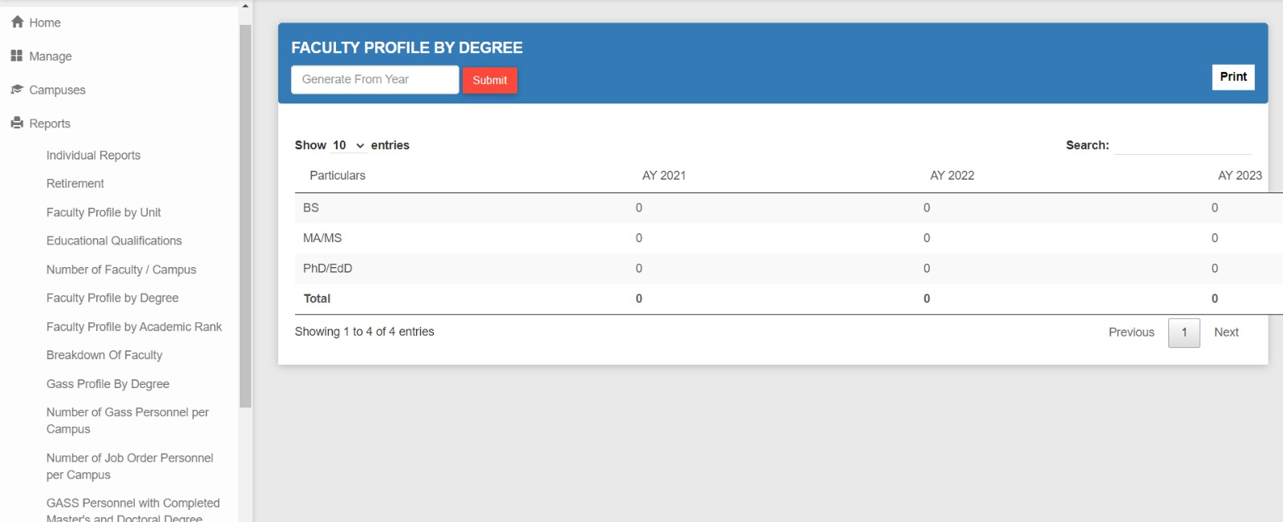

Slide 7
THANK YOU

